Slide 1
Building a Game
Pavan Jando

Slide 2

Aims
To learn about:
Game development
Life cycle of a game
Game design patterns
Unity and C#
Android life cycle
Notes:
The process of developing a game, learning about the life cycle i.e. the game loop is fundamental, other design patterns important for games, flyweight, singleton. Using unity, popular engine, good for beginners, lots of resources online, c# similar to java. Android life cycle, how an app runs.

Slide 3
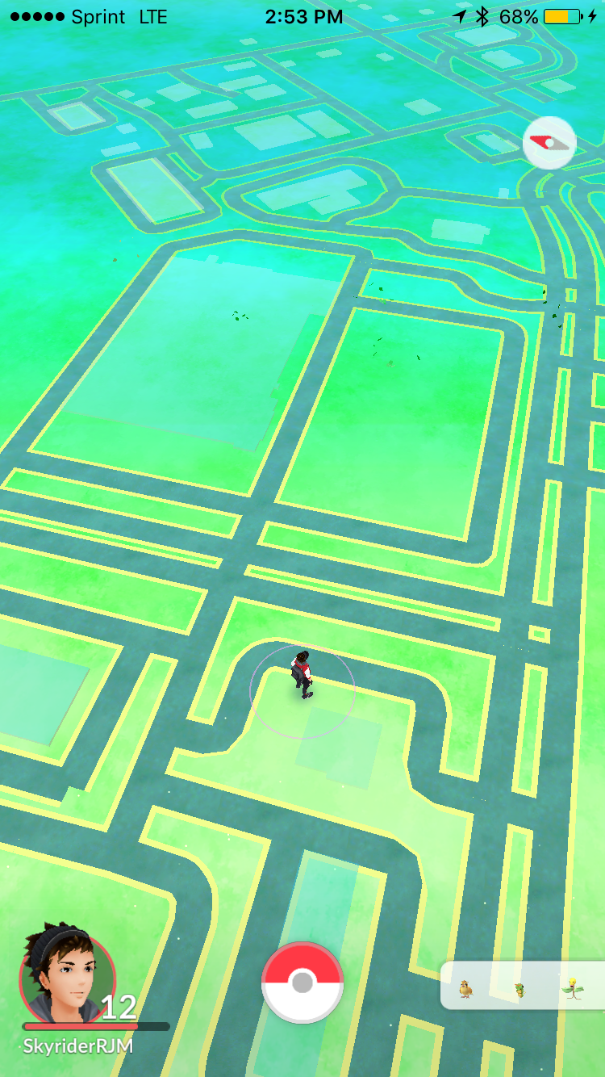
The Game
User can use their real world movements to interact with the game.
RPG that allows the user to create a warrior, mage or hunter
Battle AI enemies
Group with other players
Boss battles
Notes:
Ambitious project, singleplayer first, then add bonus items multiplayer, loot.

Slide 4


Background Topics
OpenStreetMap – provides the data needed to create the map
Unity and C#
Client – Server model
Notes:
So far I have learnt to, Download data as a text file needs to be processed, use unity and c#, created basic client server connection

Slide 5
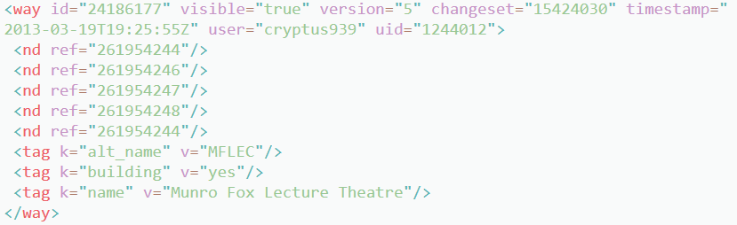
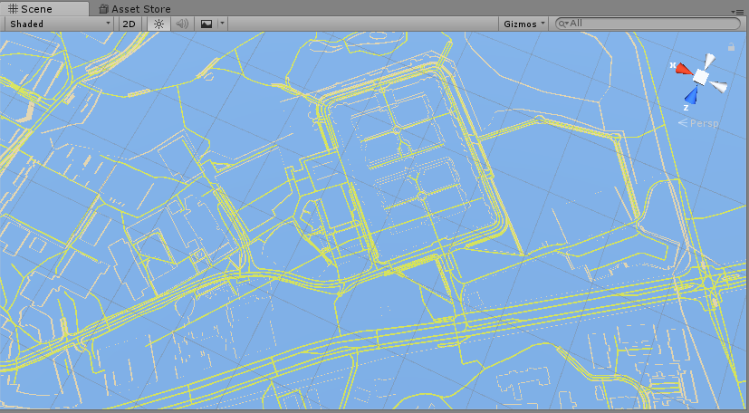
OpenStreetMap
Download map data
Process the data
Render the map
Notes:
This is how the data is sent, process nodes and ways, render the data, this is what it looks like, royal holloway

Slide 6
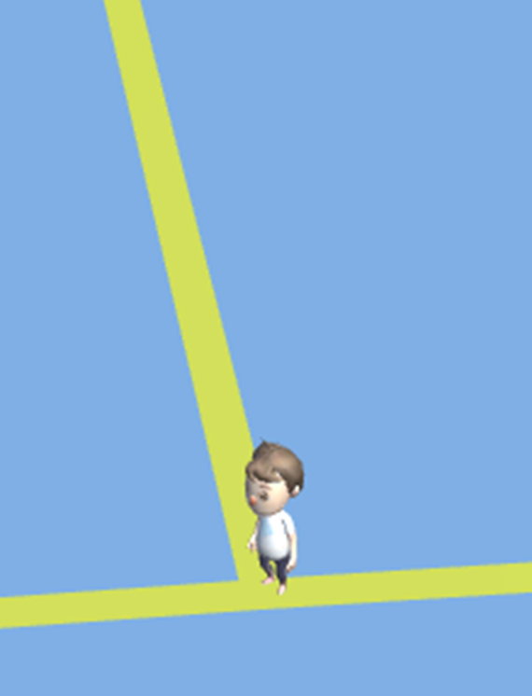
Unity
Position the game camera
Create touch input
Notes:
This a model off of the asset store I used as a point of reference for the camera, fixed angle created from models position, touch to swipe and rotate on horizontal axis

Slide 7
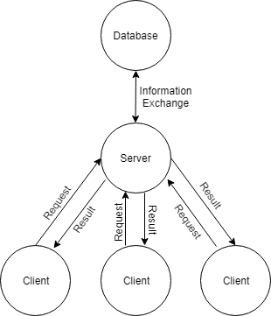
Client - Server
Multiple clients, one server
Server knows about the world
Server generates enemy spawns
Notes:
Needed for multiplayer, server knows about the spawn locations of the world, gives clients relevant spawn location, used to communicate for battles

Slide 8
Next Term
Must do:
Work on core game mechanics
Generate enemy locations
Battle Mechanics
Bonus
Multiplayer – view other players nearby
Battle between players
Notes:
The game must work single player before starting multiplayer, getting the enemies locations from server, work on the turn by turn battle mechanics.

